Slide 1
6CS005 High Performance Computing
Lecture 6 OpenMP

Slide 2
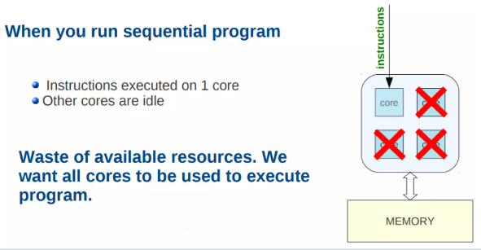
OpenMP: Motivation

Slide 3
OpenMP- What is it?
OpenMP stands for Open Multi-Processing.
OpenMP is not a new programming language.
OpenMP is an Application Program Interface(API) for
Explicit directives to indicate parallel region in the code
Portable across different architecture and platform
Shared-memory parallel programming
In c/C++ and Fortran
OpenMP consists of
Compiler directives: Start with #pragma omp
Runtime calls: Function like omp_get_thread_num(), omp_set_num_threads()
Environment variable: export OMP_NUM_THREADS=4

Slide 4
OpenMP- What is it?
The OpenMP Application Programming Interface (API) was developed to enable portable shared memory parallel programming.
An OpenMP directive is an instruction in a special format that is only understood by OpenMP-aware compilers.
OpenMP offers a shared memory programming model, where most variables are visible to all threads by default.

Slide 5
OpenMP Goals
OpenMP is designed to be a portable, scalable model that gives programmers a simple and flexible interface for developing parallel applications.
The API is designed to permit incremental approach to parallelizing an existing code, possibly in successive steps.
The impact of OpenMP parallelization is frequently localized, i.e. modifications are often needed in few places.
It is possible to write the code such that the original sequential version is preserved.
Each thread execute a parallelized section of code independently.

Slide 6
OpenMP Solution Stack
End User
End User
^{Us}er layer
Application
Prog. Layer
Directives, Compiler
OpenMP library
Environment
Variables
OpenMP Runtime library
^{Syst}em layer
OS/system support for shared memory and threading
Proc1 Proc₂ Proc₃ ProcN
HW
Shared Address Space

Slide 7
How it works
OpenMP is an implementation of multithreading, where a master thread, forks a specified number of slave threads and a task is divided among them.
The main approach is based in identifying the parallelism in the program, and not in reprogramming the code to implement the parallelism.
The section of code that is meant to run in parallel is marked with a preprocessor directive.
Each thread has a unique identifier called a thread id, where the master thread has an id of 0.
Both task and data parallelism can be achieved using OpenMP by using work-sharing constructs to divide a task.

Slide 8
OpenMP Fork/Join Model
{
The program starts as a single thread just like a sequential program. The thread that executes this code is referred to as the initial thread.
Fork
{
{
Whenever an OpenMP parallel construct is encountered, a team of threads is created (fork). The initial thread becomes the master of the team. They all execute the code enclosed in the construct.
Implicit barrier at the end of the parallel section.
Parallel region
Join
{
At the end of the construct, only the original thread continues and all other terminate (join).

Slide 9

OpenMP Programming Model
Fork-Join Parallelism:
Master thread spawns a team of threads as needed.
Parallelism added incrementally until performance goals are met: i.e. the sequential program evolves into a parallel program.
Parallel Regions
A Nested Parallel
Master Thread in red
region
Sequential Parts

Slide 10
OpenMP API
Language Extensions/
Compiler directives/
Constructs
The OpenMP API provides directives, library functions and environment variables to create and control the execution of parallel programs.
User-level runtime routines
Environment
Variables
header file <omp.h>
Notes:
DONE

Slide 11
OpenMP Core elements
The core elements of OpenMP are the constructs for thread creation, workload distribution (work sharing), data environment variables, thread synchronization, user-level runtime routines and environment variables.
OpenMP Core Elements
parallel control
structures
work sharing
data
environment
synchronization
runtime functions,
env variables
governs flow of control in the program
parallel directive
distributes work among threads
do/parallel do
and
section directives
scopes
variables
shared and private clauses
coordinates thread execution
critical, atomic and barrier directives
runtime environment
omp_set_num_threads()
omp_get_thread_num()
OMP_NUM_THREADS
OMP_SCHEDULE
Notes:
DONE

Slide 12
OpenMP Directive
General form of an OpenMP directive
Parallel construct
#pragma omp directive-name [clause[[,] clause]...] new-line
Directive-name includes: ‘parallel’, ‘for’, ‘atomic’, ‘critical’
Clause: Separated by comma, includes ‘private’, ‘share’, ‘reduction’, ‘if’, ‘num_threads’
New-line: Makes the end of the pragma statement
#pragma omp parallel [clause[[,] clause]...]
{
/* parallel section */
}

Slide 13
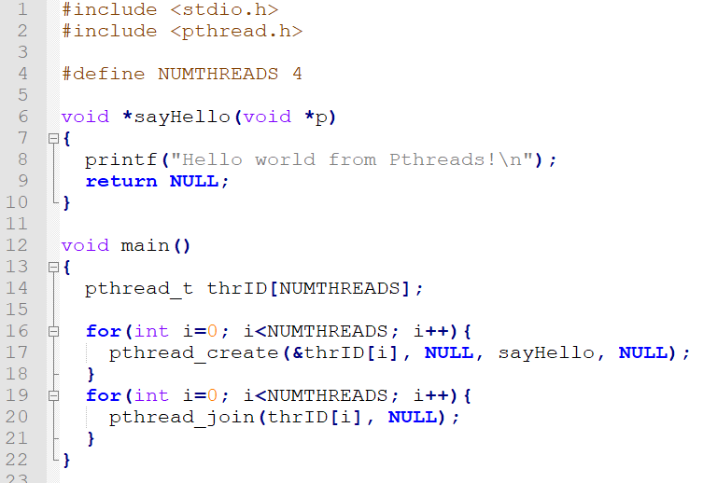
Pthread Hello World example

Slide 14
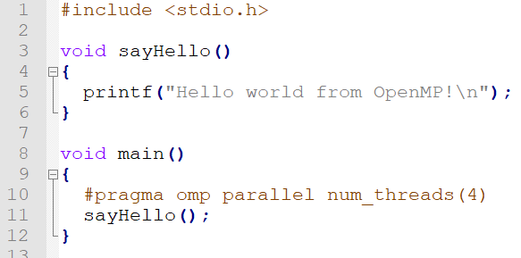
OpenMP Hello World example

Slide 15
OpenMP Hello World with specified threads

Slide 16
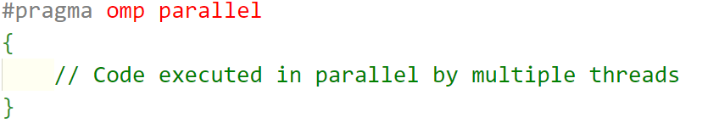
Compiler directives
Parallel Region
#pragma omp parallel
Creates a group of threads (forks) that execute the enclosed block of code in parallel
Syntax

Slide 17
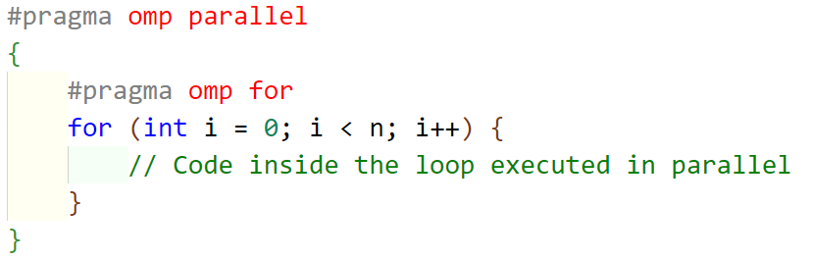
Compiler directives
For Loop Parallelization
#pragma omp for
Distributes loop iterations among the team of threads for parallel execution.
Syntax

Slide 18
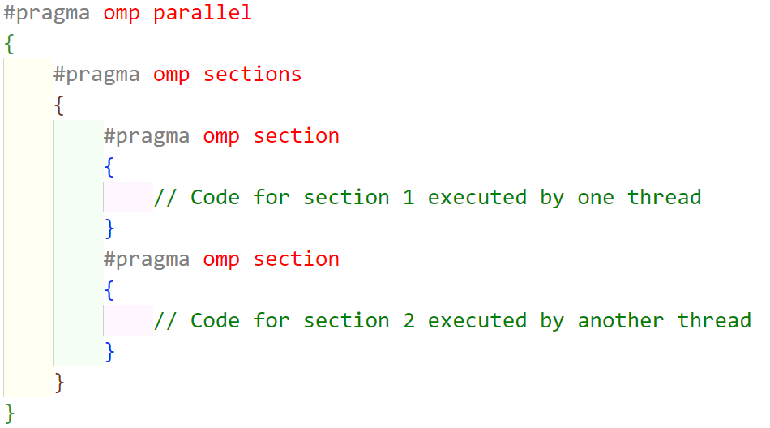
Compiler directives
Sections
#pragma omp sections
Divides code into sections, each executed by one thread in parallel.
Syntax

Slide 19
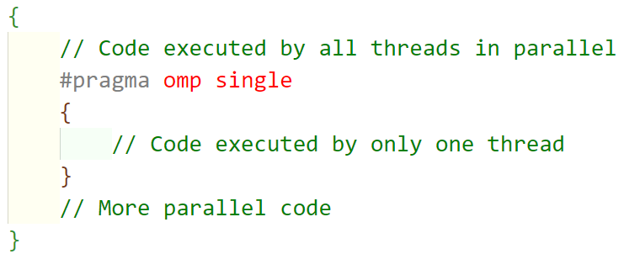
Compiler directives
Single Execution
#pragma omp single
Specifies that the enclosed block should be executed by a single thread, avoiding duplication of work.
Syntax

Slide 20
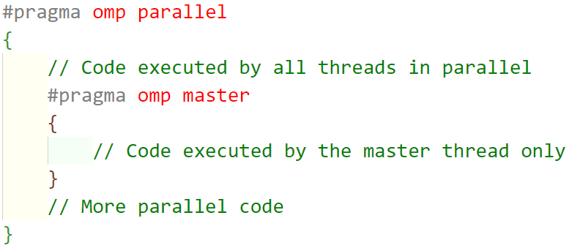
Compiler directives
Master Execution
#pragma omp master
Specifies that the enclosed block should be executed by the master thread (thread with ID 0).
Syntax

Slide 21
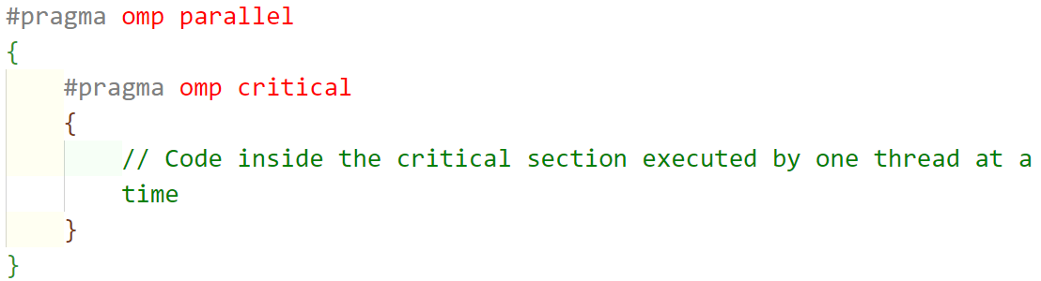
Compiler directives
Critical Section
#pragma omp critical
Specifies a critical section, ensuring that only one thread at a time executes the enclosed block.(Applies to a block of codes(critical section)
Syntax

Slide 22
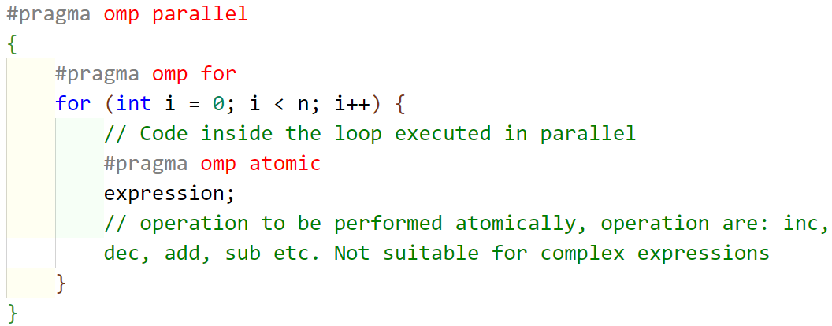
Compiler directives
Atomic Operation
#pragma omp atomic
Specifies a critical section, ensuring that only one thread at a time executes the enclosed block.(Applies to a single operation on shared variable)
Syntax

Slide 23
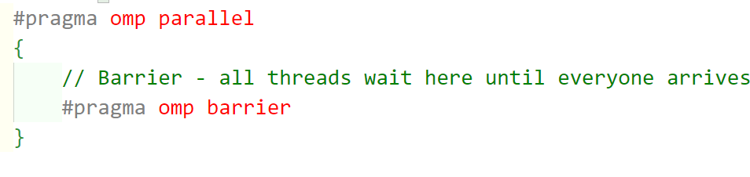
Compiler directives
OpenMP Barrier
#pragma omp barrier
When barrier encountered, all the threads in the team must reach this point(barrier) before any of them can continue execution beyond the barrier.
Syntax

Slide 24
Compiler directives: Clause
Additional statements or modifier used in conjunction with a compiler directive to provide additional information
‘private’ clause
#pragma omp parallel private(private_variable)
Ensures that each thread has its private copy of the variable ‘private_variable’
‘shared’ clause
#pragma omp parallel shared(shared_variable)
The shared(shared_variable) clause indicates that the variable ‘shared_variable’ is shared among all threads in the parallel region.

Slide 25
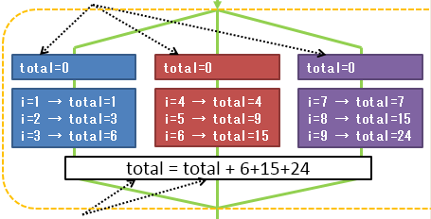
Compiler directives: Clause
‘reduction’ clause
#pragma omp parallel for reduction(operator:variable)
Eg #pragma omp parallel for reduction(+:total)
Operator: arithmetic, logical, bitwise etc.
The reduction(+:total) clause specifies that the variable total is a reduction variable, and private copies of total are created for each thread.

Slide 26
Compiler directives: Clause
‘if’ clause
#pragma omp parallel if(condition)
Eg #pragma omp parallel if(N > 50)
The if(N > 50) clause specifies that the parallel region should be executed only if the condition N > 50 is true.
‘num_threads’ clause
#pragma omp parallel num_threads(Threads)
#pragma omp parallel num_threads(4)
The num_threads(4) clause specifies that the parallel region should use only 4 threads.

Slide 27
Runtime Calls/Functions
Functions provided by the OpenMP runtime library
omp_get_num_threads()
Retrieves the number of threads in the current parallel region.
omp_get_thread_num()
Retrieves the thread number of the calling thread in the current parallel region.
omp_set_num_threads()
Sets the number of threads to be used in subsequent parallel regions.
omp_in_parallel()
It returns a nonzero value (true) if the calling thread is inside a parallel region, and 0 (false) otherwise.
omp_get_num_procs()
It provides information about the total number of hardware processors that OpenMP can potentially utilize.

Slide 28
Single Threaded Prime Numbers
#include <stdio.h>
void main()
{
int i, c;
int nstart=1, nfinish=20000;
printf("Prime numbers between %d and %d are :\n", nstart, nfinish);
for(i=nstart; i<=nfinish; i++){
for(c = 2; c <= i-1; c++){
if ( i%c == 0 )
break;
}
if ( c == i )
printf("%d\n", i);
}
}

Slide 29
Multithreaded Version - 2 threads
#include <stdio.h>
#include <pthread.h>
void *threadOne(void *p){
int i, c;
int nstart=1, nfinish=10000;
for(i=nstart; i<=nfinish; i++){
for(c=2; c <= i-1; c++){
if ( i%c == 0 )
break;
}
if ( c == i )
printf("threadOne : %d\n", i);
}
return 0;
}
void main(){
pthread_t thrID1, thrID2;
printf("threadOne : Prime numbers between %d and %d are :\n", nstart, nfinish); pthread_create(&thrID1, NULL, threadOne, NULL);
pthread_create(&thrID2, NULL, threadTwo, NULL);
pthread_join(thrID1, NULL);
pthread_join(thrID2, NULL);
}
void *threadTwo(void *p){
int i, c;
int nstart=10001, nfinish=20000;
for(i=nstart; i<=nfinish; i++){
for(c=2; c<=i-1; c++){
if ( i%c==0 )
break;
}
if ( c==i )
printf("threadTwo : %d\n", i);
}
return 0;
}

Slide 30
Multithreaded Version - 2 threads using openMp
#include <stdio.h>
#include <omp.h>
void threadOne() {
int i, c;
int nstart = 1, nfinish = 10000;
#pragma omp parallel for
for (i = nstart; i <= nfinish; i++) {
for (c = 2; c <= i - 1; c++) {
if (i % c == 0)
break;
}
if (c == i)
printf("threadOne : %d\n", i);
}
}
void threadTwo() {
int i, c;
int nstart = 10001, nfinish = 20000;
#pragma omp parallel for
for (i = nstart; i <= nfinish; i++) {
for (c = 2; c <= i - 1; c++) {
if (i % c == 0)
break;
}
if (c == i)
printf("threadTwo : %d\n", i);
}
}
int main() {
printf("Prime numbers between 1 and 20000 are:\n");
#pragma omp parallel sections
{
#pragma omp section
{
threadOne();
}
#pragma omp section
{
threadTwo();
}
}
return 0;
}

Slide 31
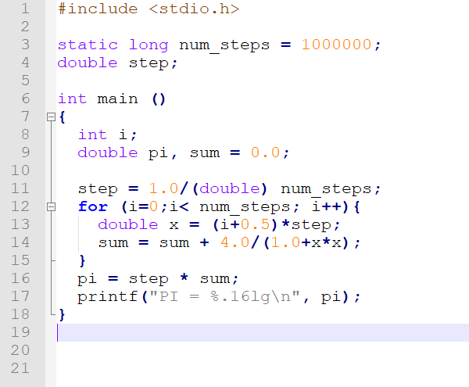
Calculating PI

Slide 32
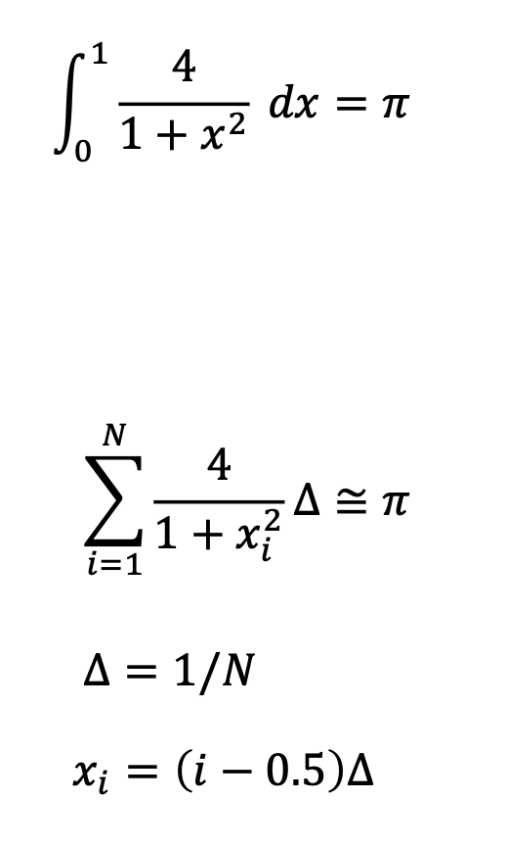
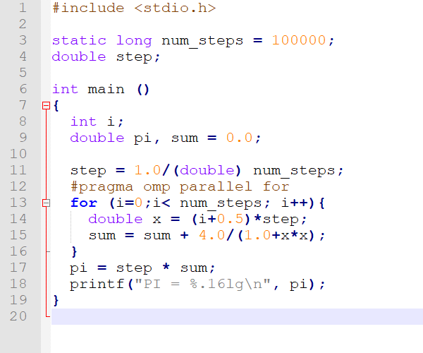
OpenMP PI

Slide 33
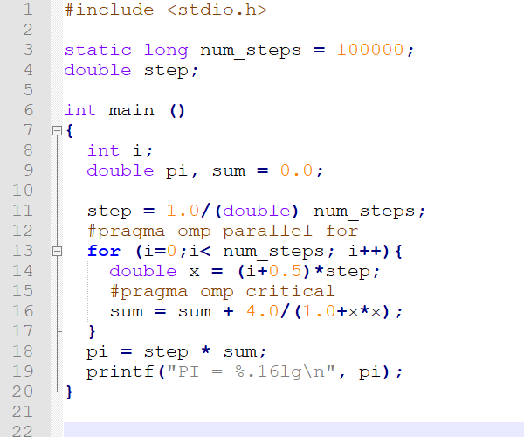
OpenMP PI Critical Section

Slide 34
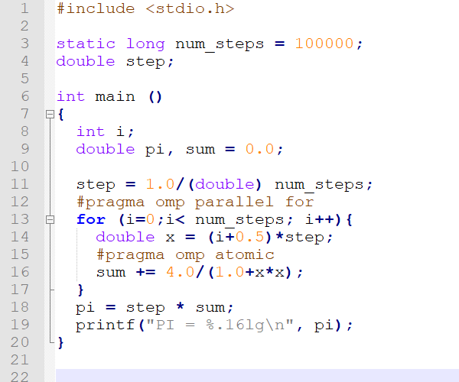
OpenMP PI Atomic Operation

Slide 35
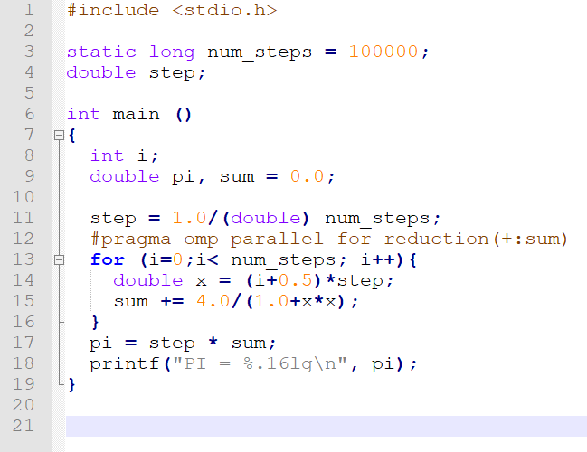
OpenMP PI Reduction Operation

Slide 36
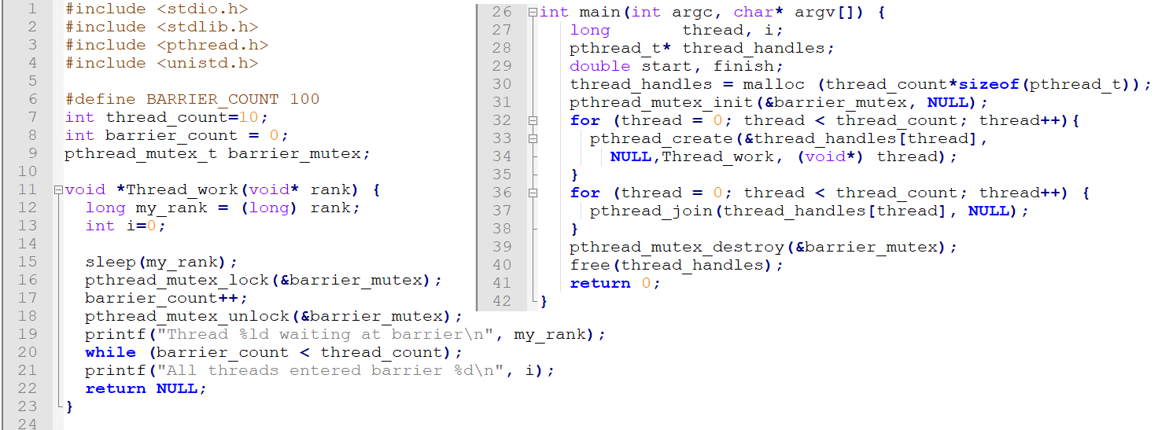
Pthread Barrier

Slide 37
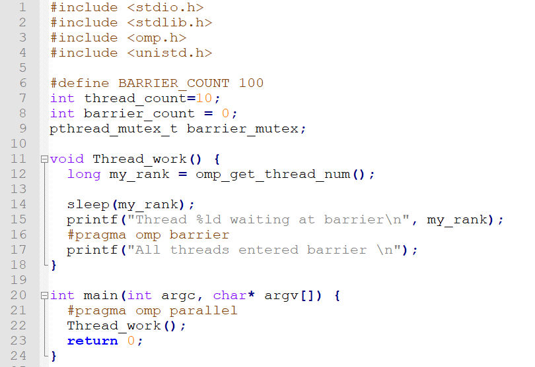
OpenMP Barrier

Slide 38
End of Lecture 6 To be continued……

